Slide 1
Clustering Techniques: K-Means vs. DBSCAN
Exploring Customer Segmentation Using Machine Learning

Slide 2
Clustering Overview:
Clustering is an unsupervised learning technique that groups similar data points based on features.
No labeled data is used; instead, it identifies patterns in the data.
Common applications: market segmentation, anomaly detection, and image segmentation
Clustering Algorithms:
K-Means: A centroid-based approach.
DBSCAN: A density-based approach.
Dataset: We will explore clustering on the Mall Customers Dataset to segment customers based on
spending habits and income.

Slide 3
Dataset Overview
Dataset: Mall Customers Data
Features: Annual Income (k$): Income of the customer (in thousands of dollars).
Spending Score (1-100): Score assigned by the mall based on the customer’s behavior.
Clustering Goal: Segment customers based on their spending score and income. Use these segments to better understand customer behavior and tailor marketing strategies

Slide 4
Theoretical Background – K-Means
What is K-Means?
K-Means partitions data into K clusters by minimizing within-cluster variance.
Algorithm Steps:
Initialize: Randomly select K centroids.
Assign: Assign each data point to the nearest centroid.
Update: Recalculate centroids based on the mean of assigned points.
Repeat: Repeat steps until convergence.
Strengths:
Computationally efficient.
Works well with spherical clusters.
Weaknesses:
Sensitive to outliers.
Requires predefined K (number of clusters).

Slide 5
K-Means Clustering
Optimal K Selection:
Using the Elbow Method, the optimal number of clusters (K) was found to be 5.
Visualization:
Cluster Centers: Visualize the centroids of the clusters on a scatter plot.
Result: 5 distinct customer groups based on income and spending score.
Evaluation Metrics:
Silhouette Score: Measures how similar points are within clusters. 0.555
Davies-Bouldin Index: Evaluates intra-cluster similarity and inter-cluster separation. (0.572),

Slide 6
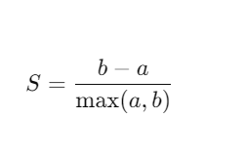
Silhouette Score:
Formula:
a= average distance between a point and other points in the same cluster.
b= average distance between a point and points in the nearest cluster.
Purpose:
Measures how well-separated the clusters are.
A higher score (closer to 1) indicates better-defined clusters.
Range: [−1,1][-1, 1][−1,1].

Slide 7
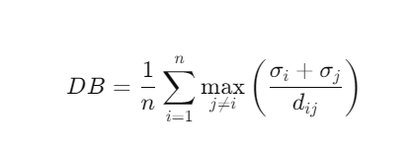
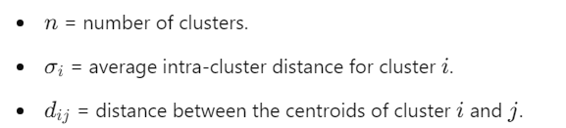
Davies-Bouldin Index
Formula
Where
Purpose:
Measures the compactness and separation of clusters.
A lower score indicates better-defined clusters.

Slide 8
Theoretical Background – DBSCAN
What is DBSCAN?
DBSCAN groups data points based on density. It defines a cluster as points within a given distance (ε) with sufficient neighbors (min_samples).
Algorithm Steps:
Identify: Find all points within a distance of ε.
Expand: Expand clusters if there are more than min_samples points in the neighborhood.
Noise: Mark points that don’t meet density requirements as noise.
Strengths:
Handles noise and outliers well.
No need to pre-define the number of clusters.
Weaknesses:
Sensitive to ε and min_samples values.
Struggles with clusters of varying density.

Slide 9
DBSCAN Results
DBSCAN Clustering:
Parameters Used:
ε = 0.5: Maximum distance for two points to be considered neighbors.
min_samples = 5: Minimum points required to form a cluster.
Visualization:
Clusters: Visualize DBSCAN clusters and outliers (points marked as noise).
Evaluation Metrics:
Silhouette Score: Calculated only for valid points (ignores noise).
Davies-Bouldin Index: Measures cluster separation and cohesion.

Slide 10
Performance:
Silhouette Score: 0.388 (lower than K-Means, indicating less cohesive clusters).
Davies-Bouldin Index: 0.789 (higher than K-Means, indicating poorer separation and
Compactness).
Strengths:
Can handle noise and outliers better than K-Means.
Does not assume a fixed number of clusters.
Limitations:
Struggled on this dataset due to weaker parameter tuning (e.g., eps=0.5 and min_samples=5).
May not perform well on datasets where clusters are not density-based or have
uniform densities

Slide 11
Comparison of Clustering Techniques
Feature | K-Means | DBSCAN
Handles Outliers | Poor | Excellent
Predefined K | Yes | No
Cluster Shape | Spherical (works with simple clusters) | Arbitrary (works with complex shapes
Parameter Sensitivity | Moderate (need to define K) | High (ε and min_samples must be tuned)

Slide 12
Conclusion
Summary:
K-Means: Works efficiently with well-separated spherical clusters but is sensitive to outliers and requires K to be pre-defined.
DBSCAN: Handles noise well and is capable of detecting clusters of arbitrary shape, but it’s sensitive to parameter selection.

Slide 13
References
https://www.geeksforgeeks.org/ml-determine-the-optimal-value-of-k-in-k-means-clustering/
https://scikit-learn.org/stable/modules/generated/sklearn.cluster.DBSCAN.html
https://towardsdatascience.com/k-means-vs-dbscan-clustering-algorithms-70c59b8d73f
https://scikit-learn.org/stable/modules/generated/sklearn.metrics.davies_bouldin_score.html
Github - https://github.com/SanduniMarasingha/Individual-assignment-Machine-learning-tutorial/tree/main

